Slide 1
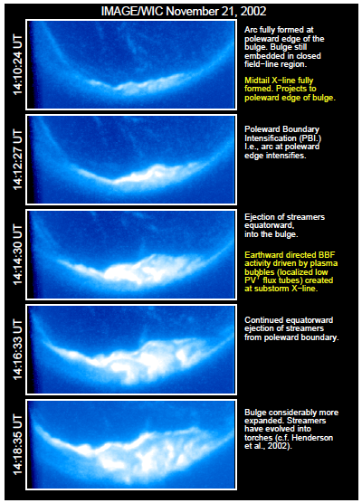
What’s a “substorm”?
Began with observations of fast, nightside-localized aurora.
Named after hypothesis that space weather storm is made of many substorms (nope.jpg).
Occur at Mercury, Jupiter, elsewhere.
While we now know that it is related to the release of built up energy in the tail, there are many, many open questions still!

Slide 2
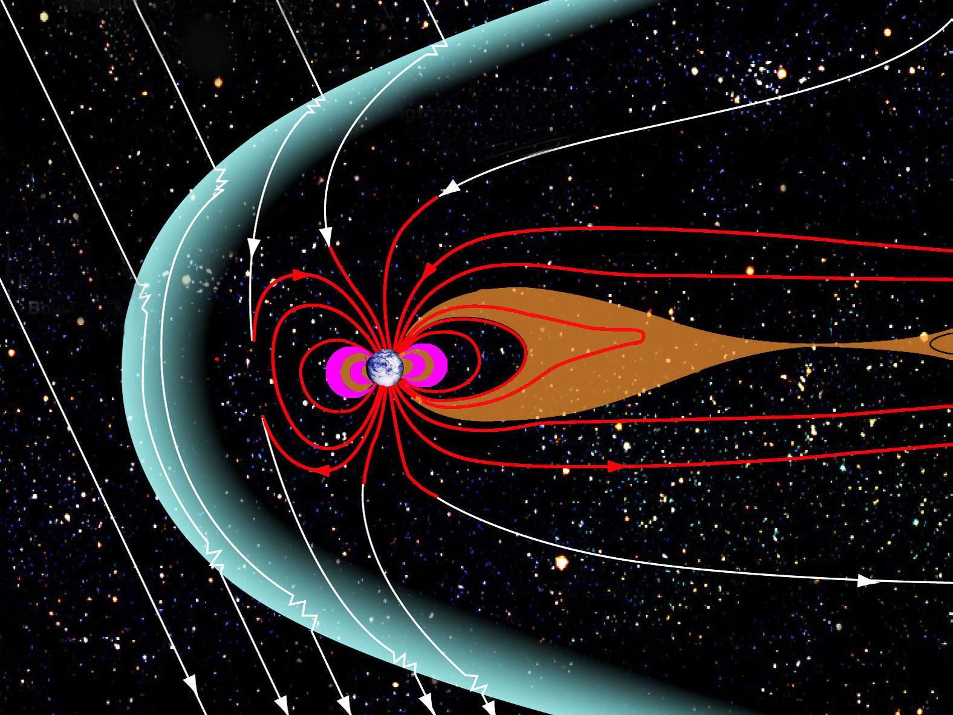
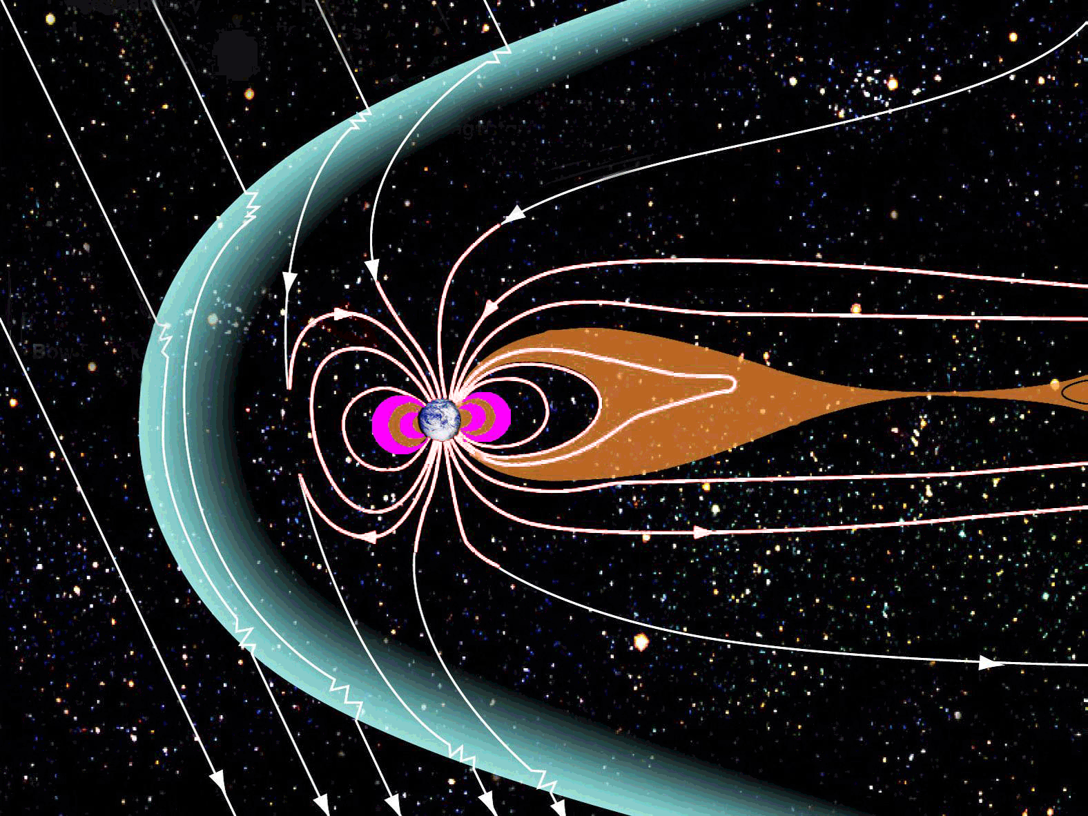


Slide 3
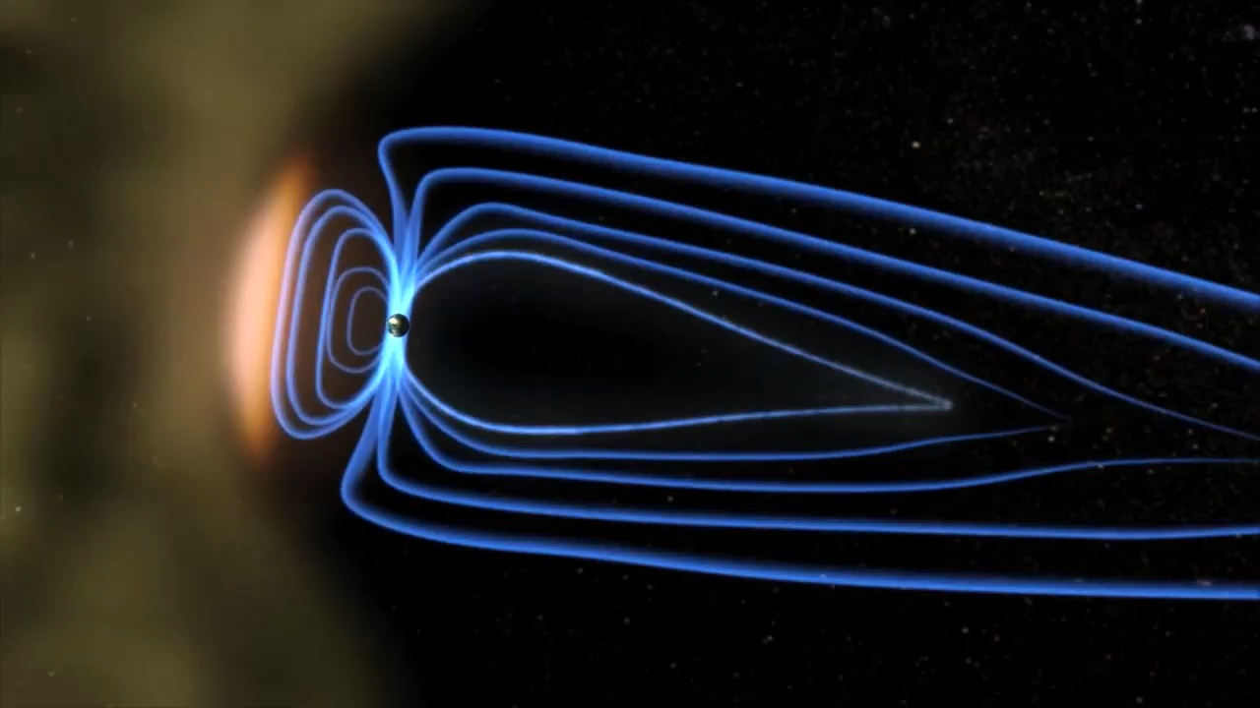

Slide 4
But why?
What precipitates [reconnection/current disruption]?
Or “Why do substorms happen when they do?”
Critical threshold in:
Open magnetic flux? (Unlikely [Boakes et al., 2009])
Kappa parameter? [Buchner and Zelenyi, 1987]
Something else?
For now, we’ll assume a parameter that is proportional to the energy accumulated in the magnetotail lobes.
Notes:
Flux tubes are colour-coded by fluxes from Polar
The MEO orbit is a GPS orbit

Slide 5

A toy model of substorms
Substorm is in a generic class of integrate-and-fire models
(like neuron models): energy builds over time until a threshold is reached. Then, the energy is released explosively down tail.
The Minimal Substorm Model [Freeman and Morley, 2004] is solar-wind driven neuron model of substorms. It has only three rules and one free parameter
Notes:
Flux tubes are colour-coded by fluxes from Polar
The MEO orbit is a GPS orbit

Slide 6
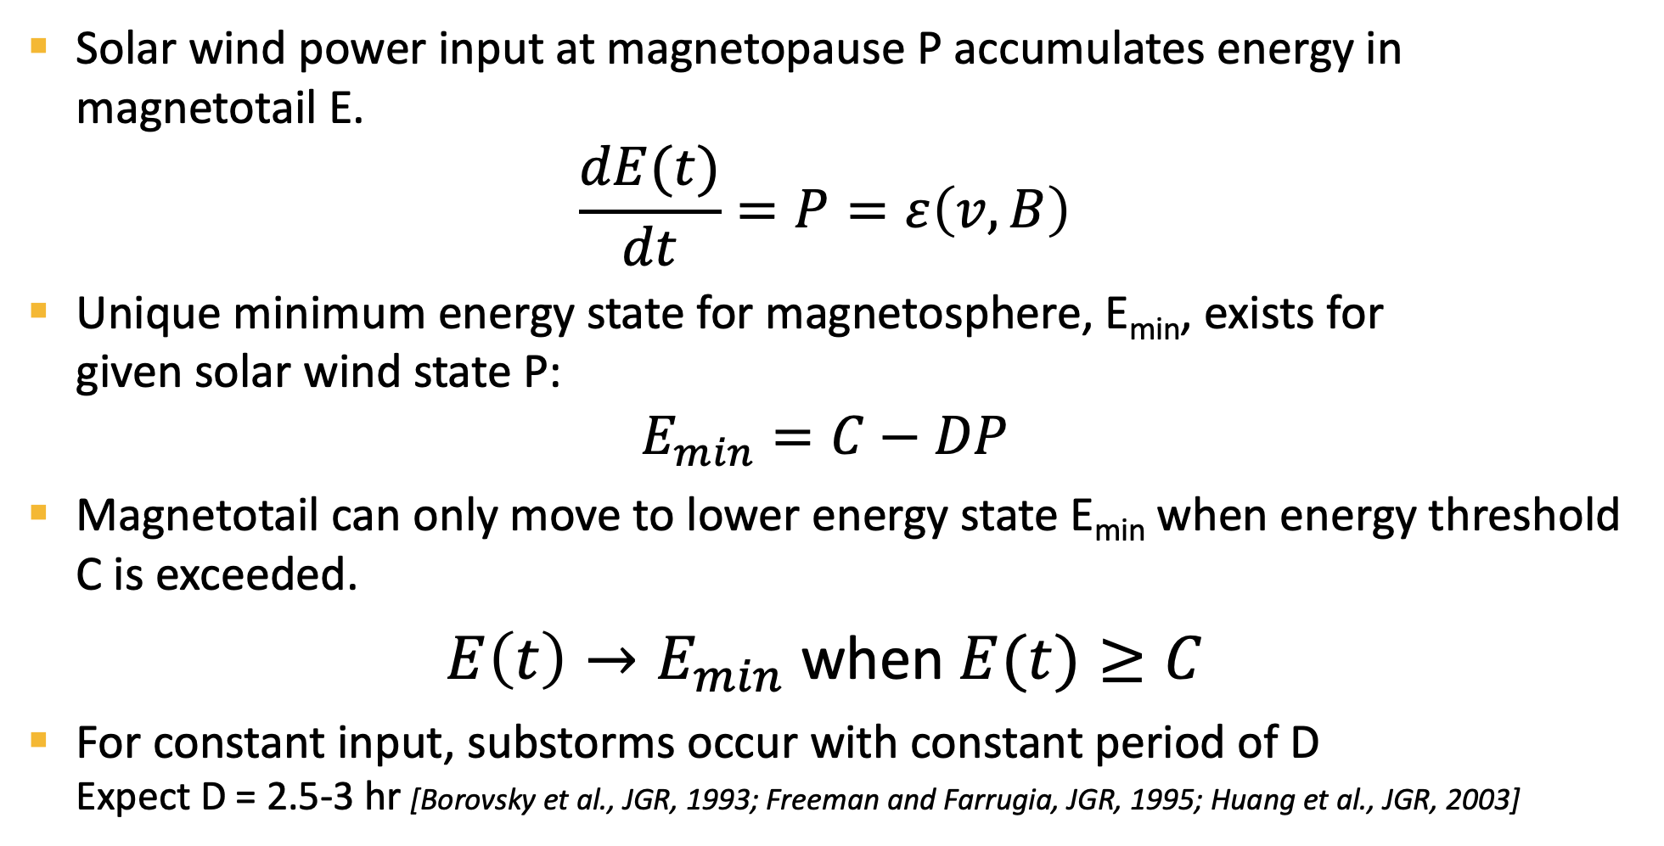
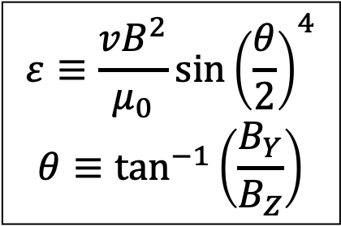
Simple loading-unloading
Solar wind power input at magnetopause P accumulates energy in magnetotail E.
$$\frac{dE(t)}{dt}=P=ε\left(v,B\right)$$
Unique minimum energy state for magnetosphere, E_{min}, exists for given solar wind state P:
$$E_{min}=C−DP$$
Magnetotail can only move to lower energy state E_{min} when energy threshold C is exceeded.
$E\left(t\right)→E_{min}$ when $E(t)≥C$
For constant input, substorms occur with constant period of D Expect D = 2.5-3 hr [Borovsky et al., JGR, 1993; Freeman and Farrugia, JGR, 1995; Huang et al., JGR, 2003]
$$ε≡\frac{vB^{2}}{μ_{0}}{\sin\left(\frac{θ}{2}\right)}^{4}$$
$$θ≡\tan^{−1}\left(\frac{B_{Y}}{B_{Z}}\right)$$
Notes:
Flux tubes are colour-coded by fluxes from Polar
The MEO orbit is a GPS orbit

Slide 7
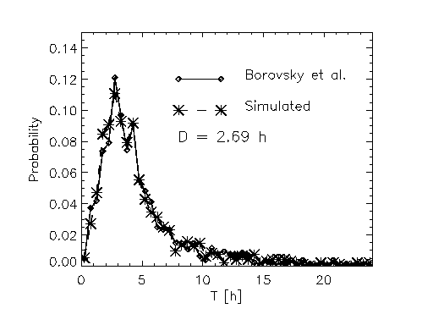
Finding free parameter, D
Compared distribution of inter-substorm intervals from model with those observed by Borovsky et al. 1993.
Energy
Time
Distributions similar at 95% confidence for limited range of D – using both χ² and K-S test.
Range of best-fit D falls in expected range based on observed recurrent substorms
Notes:
Flux tubes are colour-coded by fluxes from Polar
The MEO orbit is a GPS orbit

Slide 8
Our Goal: Create MSM.py
Use solar wind input that we’ve been using so far in class to read any IMF/solar wind file.
Use the values in this file to get solar wind power input, integrate to solve our differential equation.
Whenever we cross the energy threshold, mark a substorm
Create the time-energy plot displayed on the previous page.
Create a file that lists the onset time of substorms based on the MSM.
Turn this into a reusable tool that can be called from the command line.

Slide 9
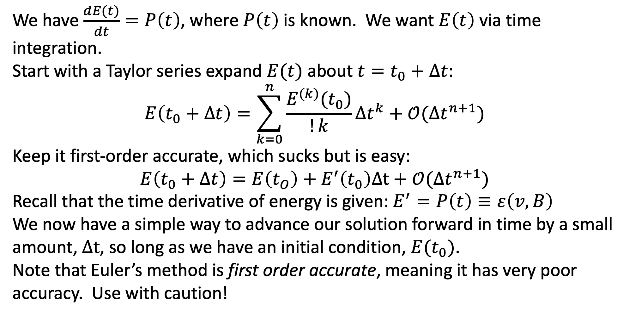
Numerical Integration: Euler’s Method
We have $\frac{dE(t)}{dt}=P\left(t\right)$, where $P\left(t\right)$ is known. We want $E\left(t\right)$ via time integration.
Start with a Taylor series expand $E(t)$ about $t=t_{0}+Δt$:
$$E\left(t_{0}+Δt\right)=\sum_{k=0}^{n}{\frac{E^{(k)}(t_{0})}{!k}Δt^{k}}+𝒪(Δt^{n+1})$$
Keep it first-order accurate, which sucks but is easy:
$$E\left(t_{0}+Δt\right)=E\left(t_{O}\right)+E^{′}\left(t_{0}\right)Δt+𝒪(Δt^{n+1})$$
Recall that the time derivative of energy is given: $E^{′}=P\left(t\right)≡ε\left(v,B\right)$
We now have a simple way to advance our solution forward in time by a small amount, $Δt$, so long as we have an initial condition, $E(t_{0})$.
Note that Euler’s method is first order accurate, meaning it has very poor accuracy. Use with caution!

Slide 10
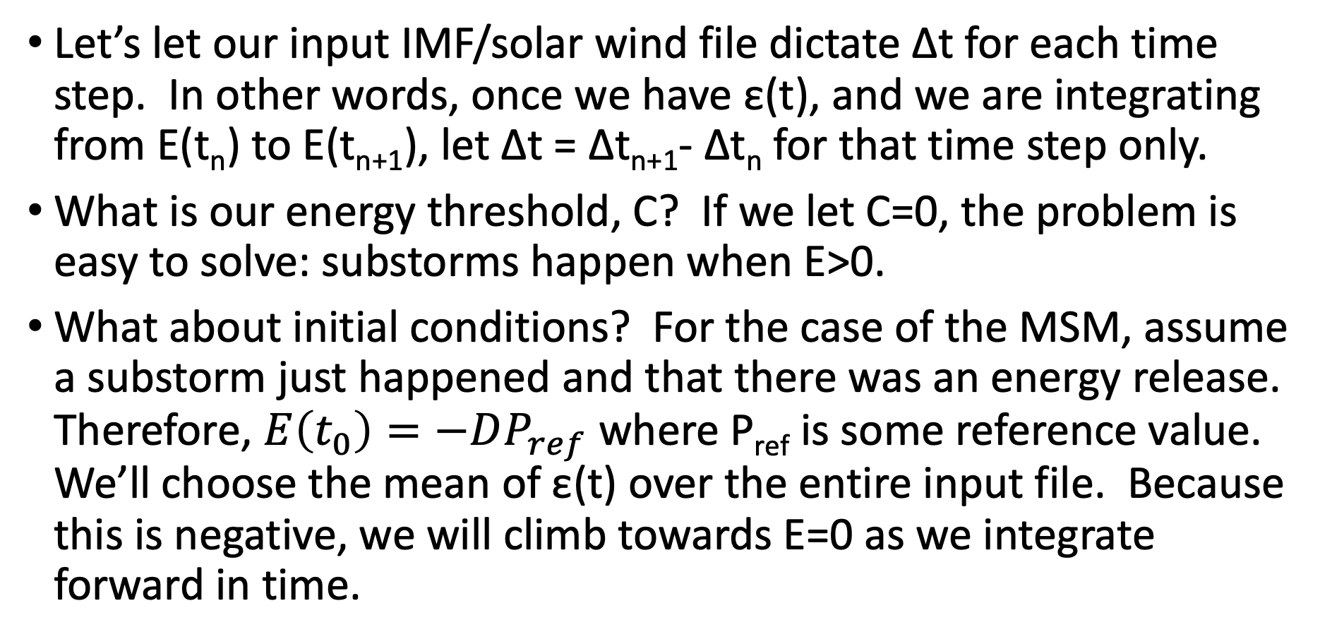
Some Considerations:
Let’s let our input IMF/solar wind file dictate Δt for each time step. In other words, once we have ε(t), and we are integrating from E(t_{n}) to E(t_{n+1}), let Δt = Δt_{n+1}- Δt_{n} for that time step only.
What is our energy threshold, C? If we let C=0, the problem is easy to solve: substorms happen when E>0.
What about initial conditions? For the case of the MSM, assume a substorm just happened and that there was an energy release. Therefore, $E\left(t_{0}\right)=−DP_{ref}$ where P_{ref} is some reference value. We’ll choose the mean of ε(t) over the entire input file. Because this is negative, we will climb towards E=0 as we integrate forward in time.

Slide 11
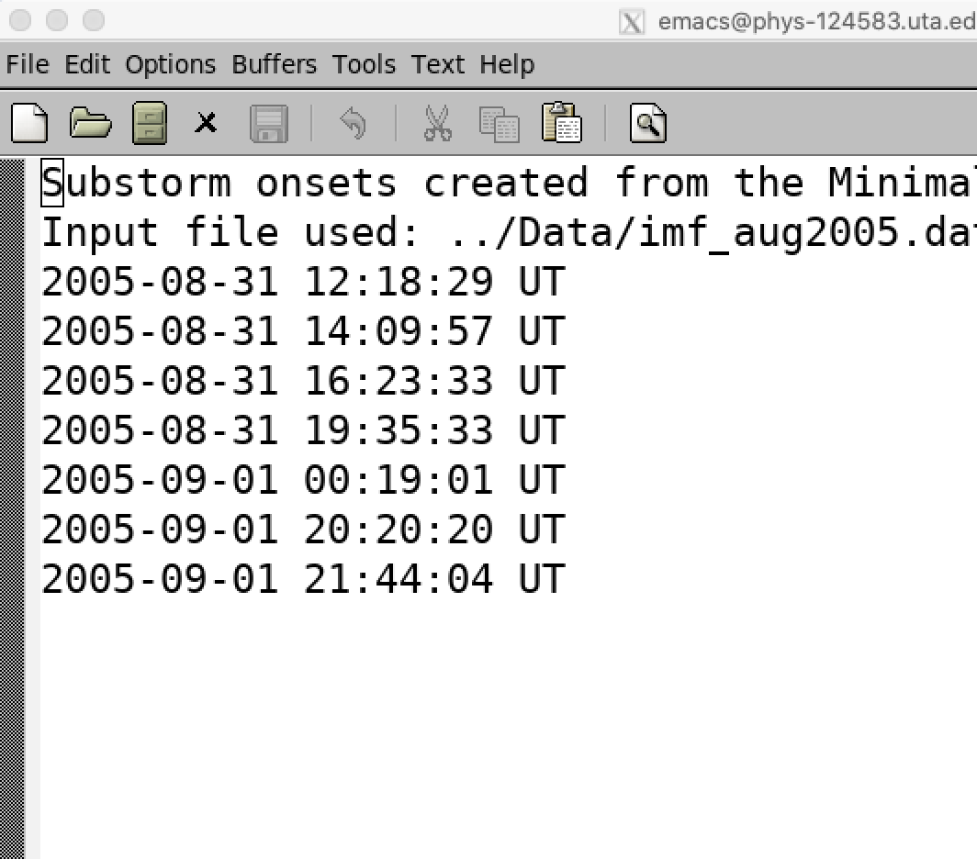

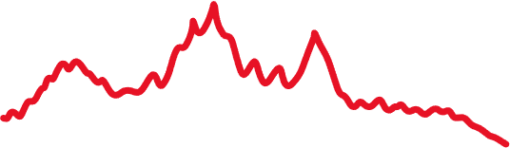
Final Goals: Plot & Timings

Slide 12
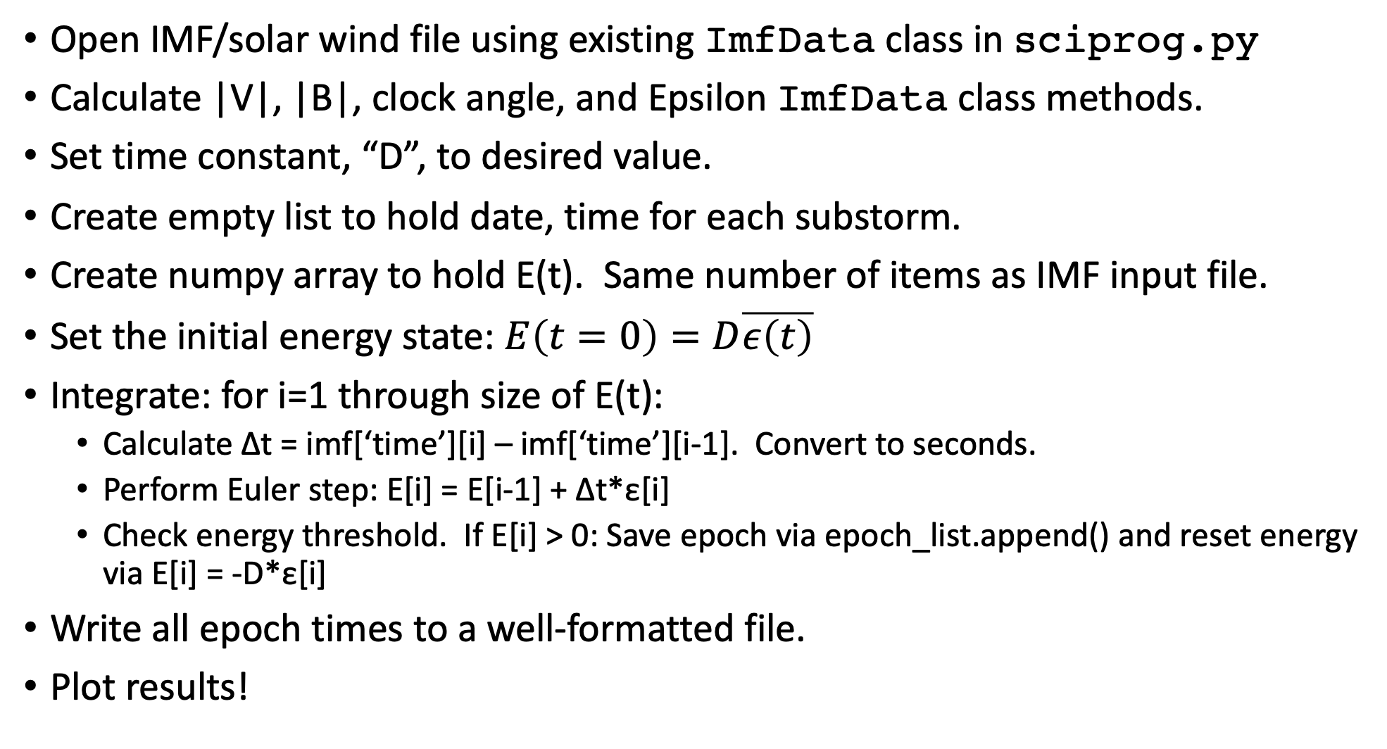
Program To-Do:
Open IMF/solar wind file using existing ImfData class in sciprog.py
Calculate |V|, |B|, clock angle, and Epsilon ImfData class methods.
Set time constant, “D”, to desired value.
Create empty list to hold date, time for each substorm.
Create numpy array to hold E(t). Same number of items as IMF input file.
Set the initial energy state: $E\left(t=0\right)=D\overline{ε\left(t\right)}$
Integrate: for i=1 through size of E(t):
Calculate Δt = imf[‘time’][i] – imf[‘time’][i-1]. Convert to seconds.
Perform Euler step: E[i] = E[i-1] + Δt*ε[i]
Check energy threshold. If E[i] > 0: Save epoch via epoch_list.append() and reset energy via E[i] = -D*ε[i]
Write all epoch times to a well-formatted file.
Plot results!

